Slide 1

ADVENTURE WORKS SALES & CUSTOMER ENGAGEMENT ANALYSIS

Slide 2
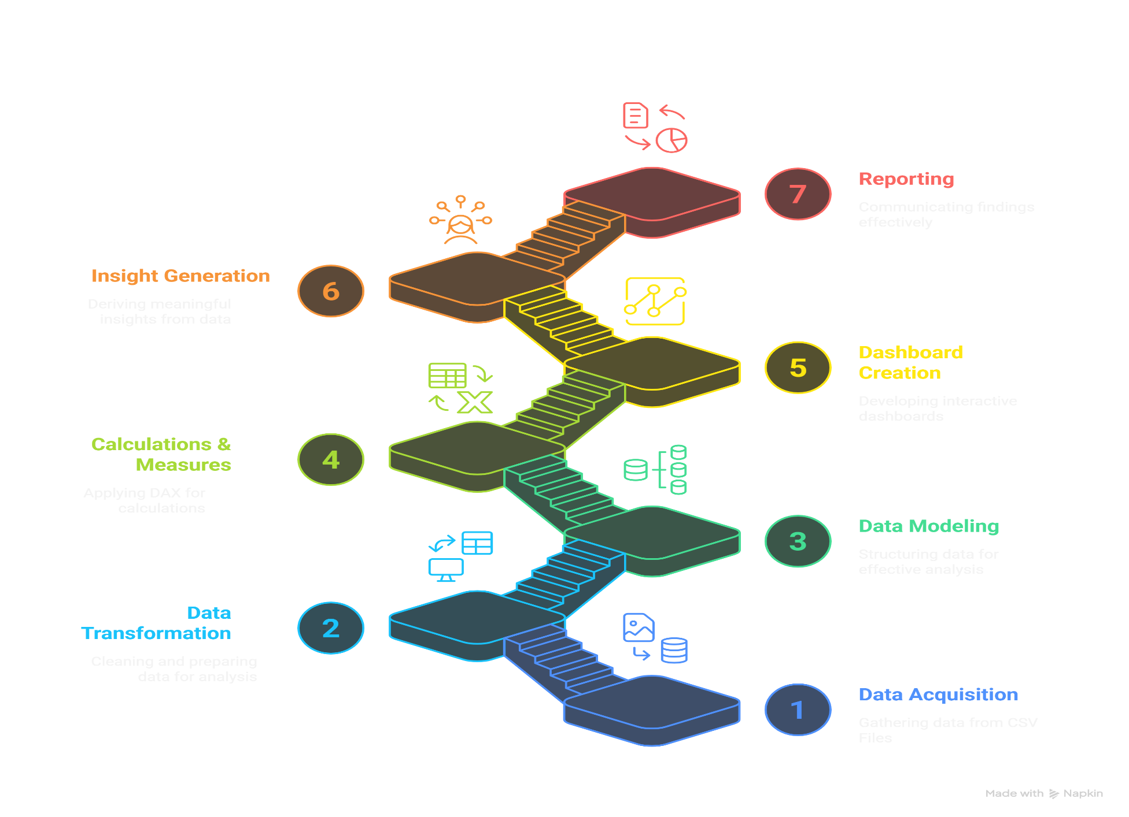
PROCESS OVERVIEW

Slide 3
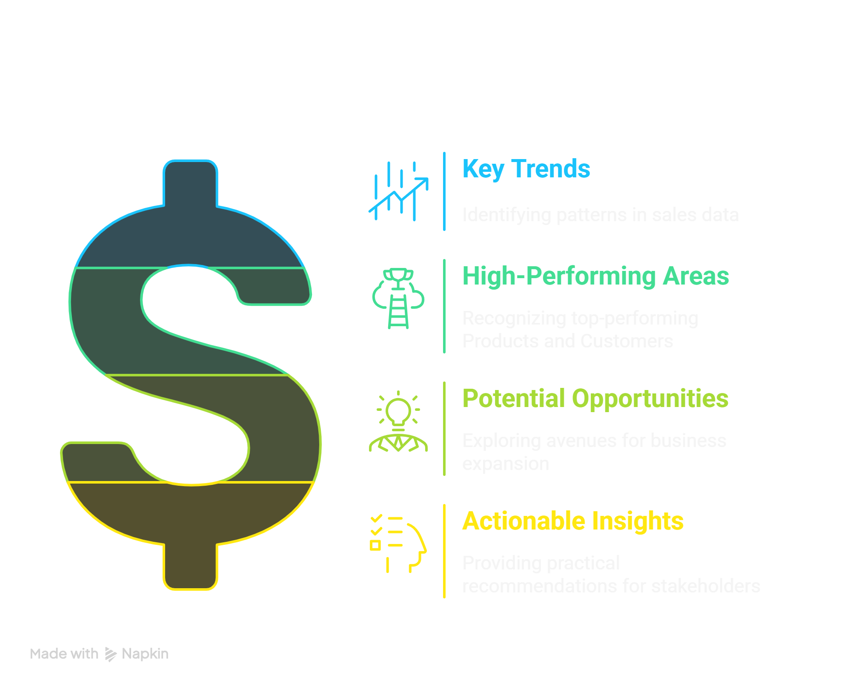
PROJECT OBJECTIVE

Slide 4
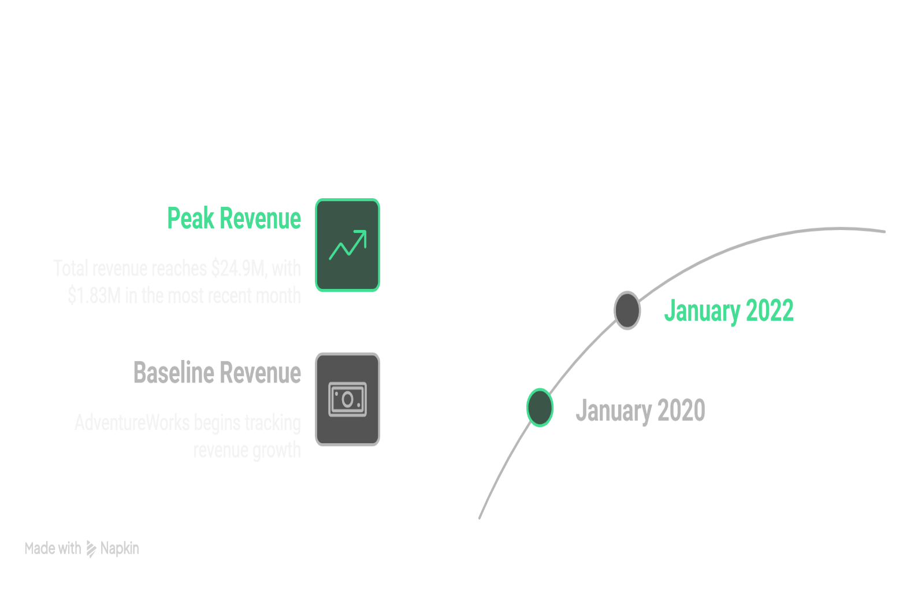
INSIGHTS
Finding:
AdventureWorks demonstrates a consistent and positive upward trend in overall revenue from January 2020 to January 2022, reaching a total of $24.9M.
Detailed Analysis:
This sustained growth indicates a strong market presence and effective sales strategies over the analyzed period.
The significant revenue spike observed around late 2021 warrants further investigation to understand the contributing factors, such as successful marketing campaigns, new product launches, or seasonal demand surges.
Maintaining this growth trajectory will be crucial for future success.

Slide 5
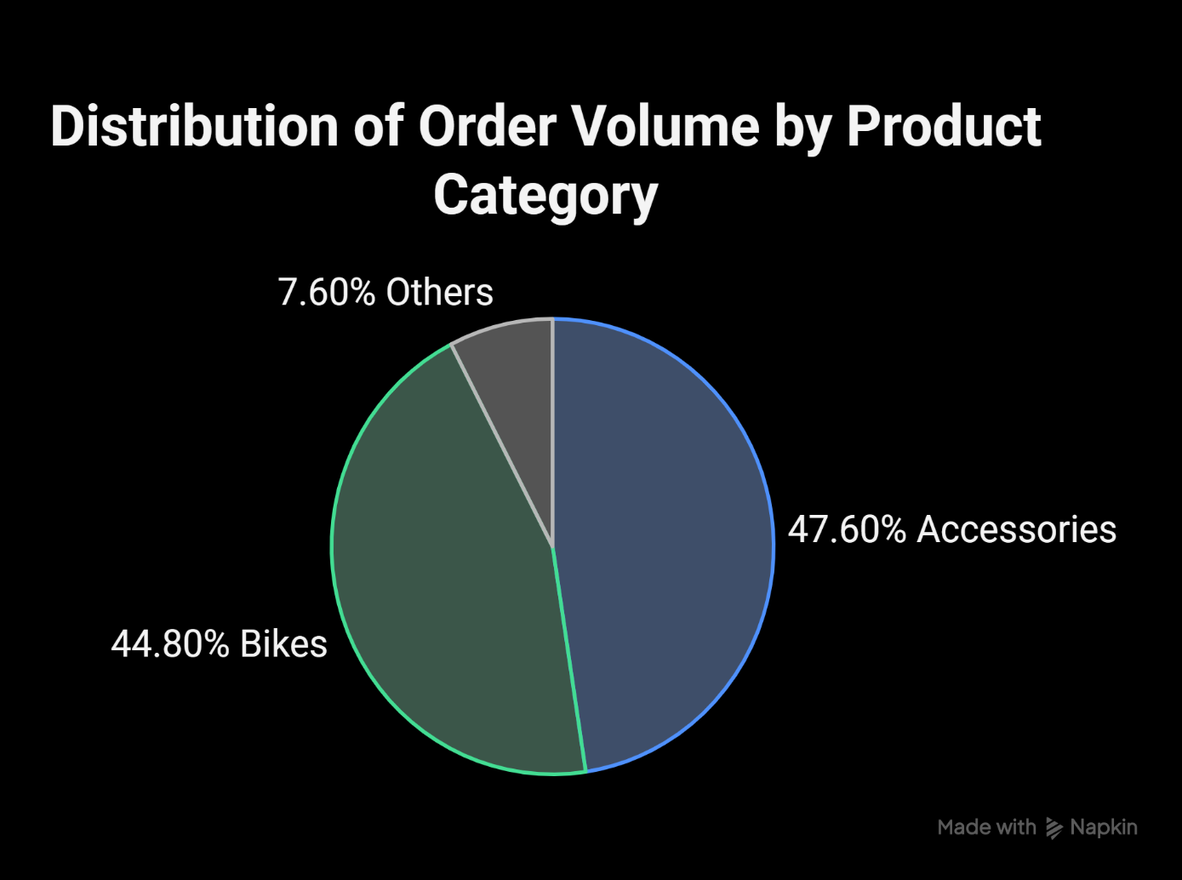
INSIGHTS
Finding:
The "Accessories" and "Bikes" product categories dominate order volume, accounting for 47.6% and 44.8% of total orders (25.2K), respectively.
Detailed Analysis:
This highlights the core product lines driving customer activity. Understanding the specific products within these categories that are most popular (e.g., "Water Bottle - 30 oz." in Accessories) can inform inventory management, marketing focus, and producdevelopment efforts.
The lower order share of "Clothing"(7.6%)suggests a potential area for growth or a strategic focus on the higher-volume categories.

Slide 6
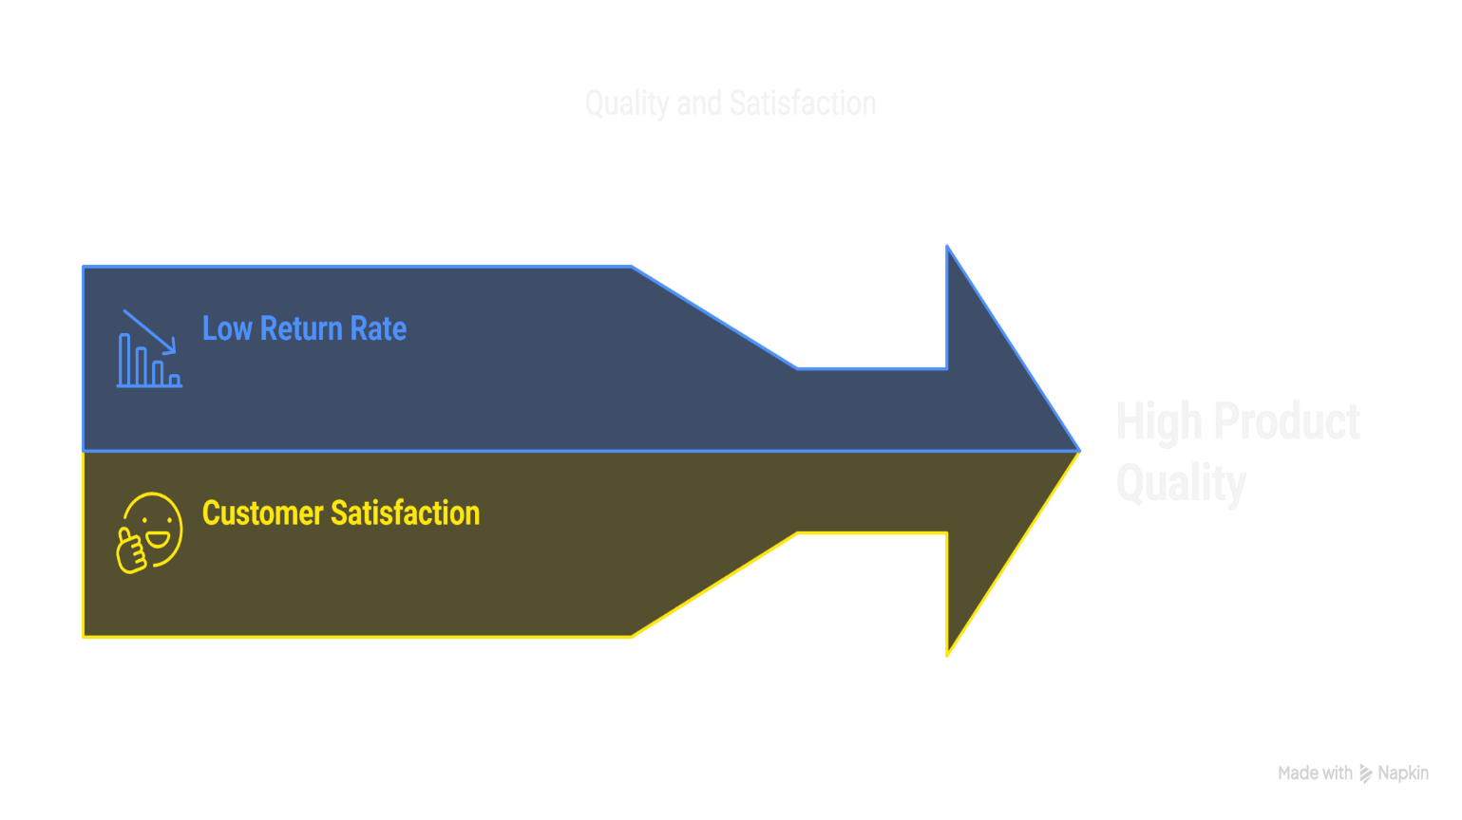
INSIGHTS
Finding:
The overall product return rate is a low 2.17%, suggesting a high level of product quality and customer satisfaction with their purchases.
Detailed Analysis:
A low return rate minimizes costs associated with returns processing and reinforces a positive brand image.
However, the identification of "Shorts" as the most returned product type (even with a low overall rate) warrants a focused investigation into potential issues with sizing, material, or product description to further enhance customer satisfaction.

Slide 7

INSIGHTS
Finding:
Sales are heavily concentrated in North America (United States and Canada) and Europe (United Kingdom, France, and Germany), as indicated by the regional sales map.
Detailed Analysis:
This geographical concentration highlights the current core markets for AdventureWorks. Understanding the specific factors driving success in these regions can inform strategies for potential expansion into other territories.

Slide 8
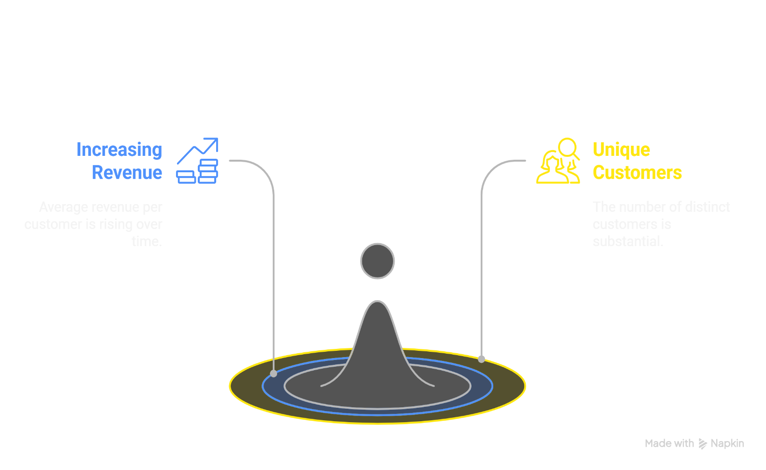
INSIGHTS
Finding:
AdventureWorks boasts a significant base of 17.4K unique customers, with an increasing average revenue per customer over time, reaching $1,431.
Detailed Analysis:
The growing revenue per customer signifies increasing customer loyalty and potentially higher purchase frequency or average order value. Understanding the drivers behind this trend, such as effective customer relationship management or successful upselling/cross-selling initiatives, is crucial for sustaining this positive momentum.

Slide 9
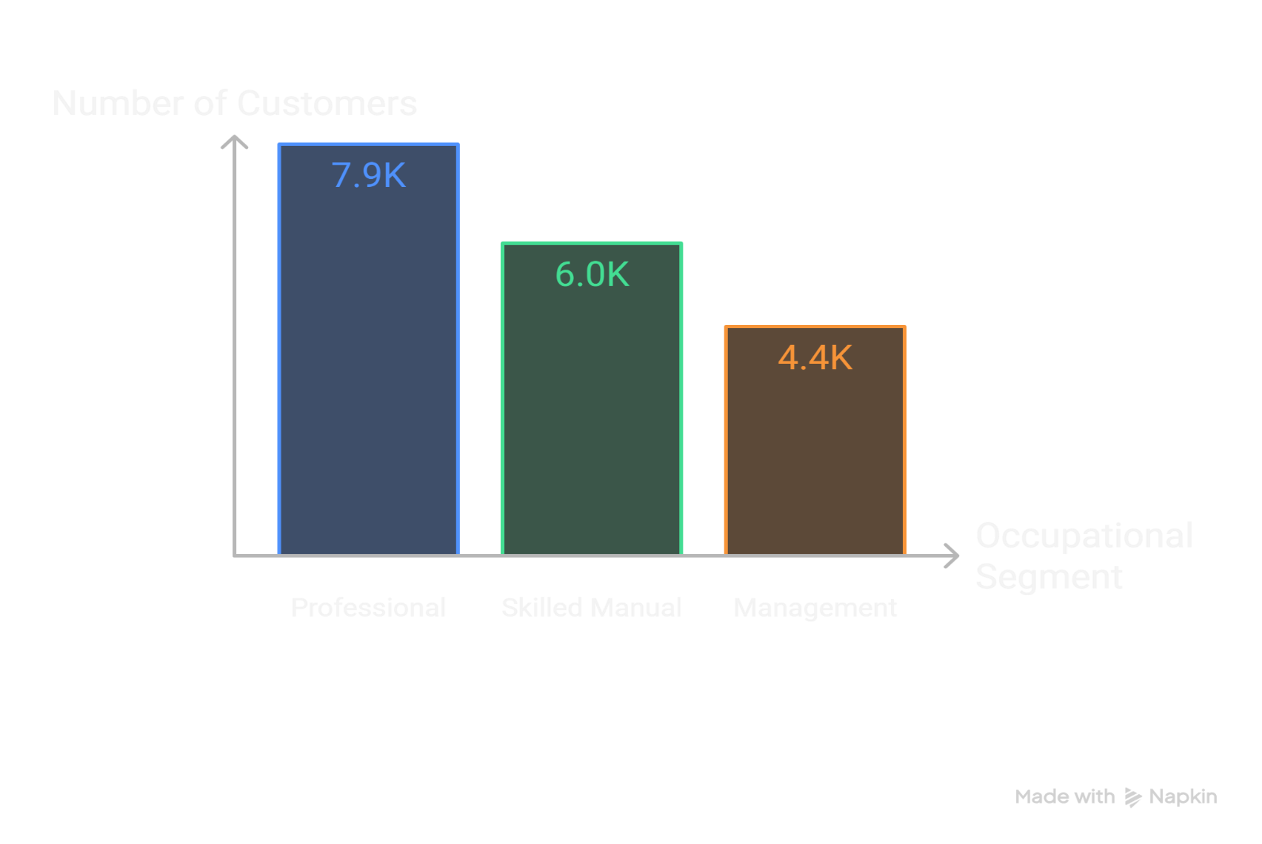
INSIGHTS
Finding:
The largest occupational segment among AdventureWorks' customer base is "Professional" (7.9K), followed by "Skilled Manual" (5.0K) and "Management" (4.4K).
Detailed Analysis:
This demographic insight can be leveraged to tailor marketing messages, product positioning, and communication channels to resonate with the largest customer groups.
Understanding the needs and preferences of these occupational segments can lead to more effective customer acquisition and retention strategies.

